Slide 1
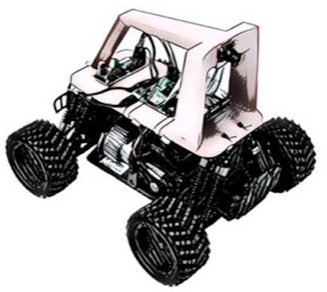
AI Racing League
A Code Savvy Program
Questions: kidscode@codesavvy.org
Dan McCreary
CoderDojo Mentor and AI Researcher at Optum
April 12th, 2021
On “track” to learn AI

Slide 2
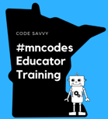

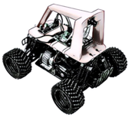

About Code Savvy
https://codesavvy.org
Special Events
MN State Fair
Hackathons
LED Costume Contests
AI Racing League
Code Clubs
Code Camps
Mentor Training
Virtual Learning
STEM Curriculum
Corporate Programs
Twin Cities
Rebecca CoderDojo
Northfield etc.
Annual Challenge
Teaching Computer Science
Teacher Education
@mncodes

Slide 3
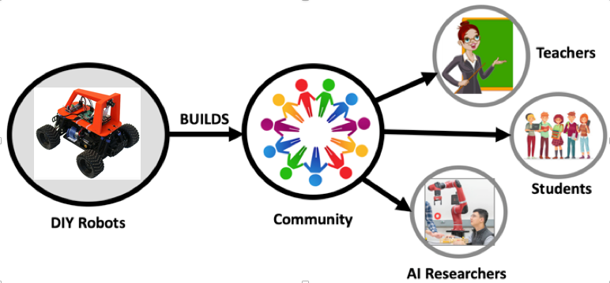
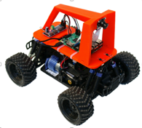
What is the AI Racing League?
A new Code Savvy Program working closely with CoderDojo Twin Cities
A way to get students involve in STEM using a fun robot activity
A curriculum based around the popular “Donkey Care” design
A way to build a community
Teachers
CoderDojo Mentors
Students
AI Researchers (Optum)
Twin Cities

Slide 4
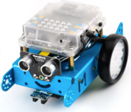
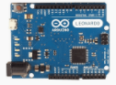
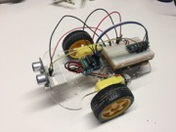
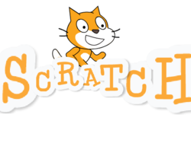

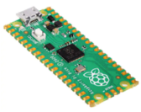
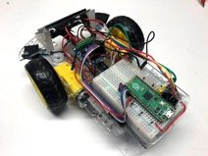
CodeDojo TC Curriculum (Fall 2021)
Arduino Uno (C)
$25 Arduino Robot (C)
mbot
(scratch)
?
200x
Web
Mobile Apps
Unity
AI Racing League
$4 Micropython
Raspberry Pi Pico
Pico Robot
MicroPython
Student driven “Agile” mentoring / rhizomatic learning / concept cards

Slide 5
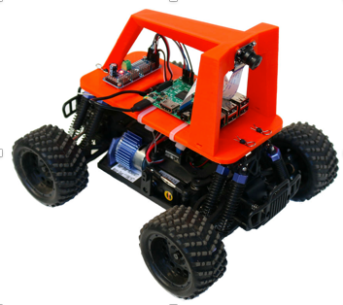
The AI Racing League Methodology
3D printed roll cage ($50)
“High touch” hands-on learning for single-day events
Mentors work directly with students
Background checks (free) for all students
No more than three students per mentor
No fees – leverage STEM grants
Concept cards are used to decompose complex learning into components
Easy to integrate into local CoderDojo programs
All content is licensed for noncommercial reuse
Focus on low-cost but fun events!
Camera ($25)
Raspberry Pi 4 ($60)
RC Car Chassis
($100-$200)
Total Cost: $250 to $400

Slide 6
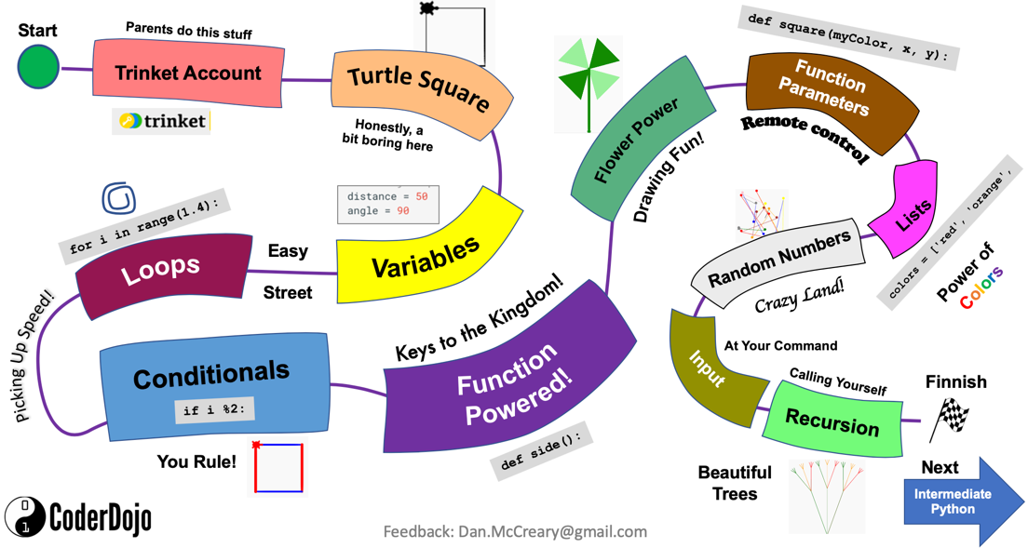
Introduction to Python Journey Map

Slide 7


AI Racing League Concept Cards
Motors
Raspberry Pi
Python
Computer Vision
Machine Learning
Intermediate Concepts
Starting Concepts
GPU
TensorFlow
Finish!
UNIX
One double-sided laminated card per concept. Activities and suggested questions on the front. Answers on the back.
Starting Concepts (green borders) have no dependencies on other concepts. They should be attempted first.
Intermediate Concepts (blue borders) should be for students that have completed most of the starting concepts or are already familiar with the topic.
Finishing Concepts (black borders) should be attempted after the intermediate concepts are mastered.
Training a Model
Finishing Concepts
Notes:
At CoderDojo these are called “Sushi Cards” - they are single bit concepts.
http://kata.coderdojo.com/wiki/Category:Sushi_Card
For inspiration check out these cards: https://www.teacherspayteachers.com/Browse/Search:concept%20cards
https://www.teacherspayteachers.com/Browse/Search:concept%20cards%20robotics
See also: https://projects.raspberrypi.org/en/projects/build-a-buggy

Slide 8
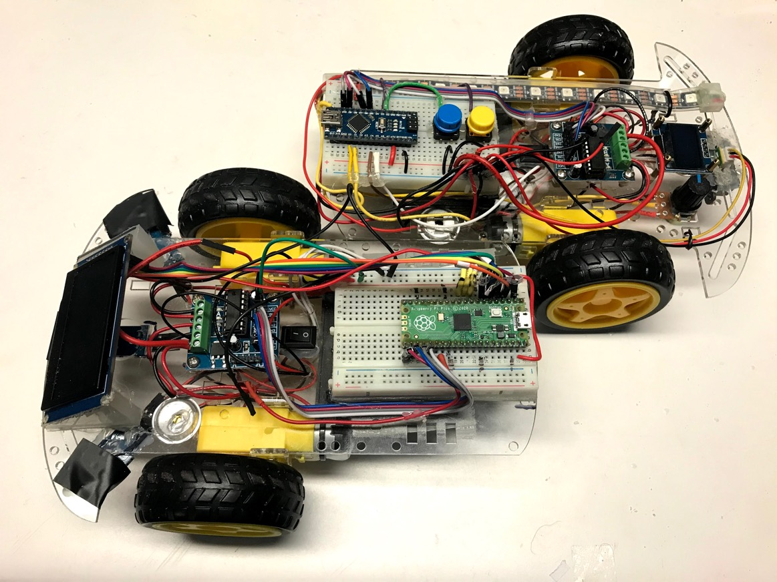
Sustainable Robotics
Design robots to make it easy to upgrade your robot
Easy to upgrade your:
Processor
Sensors
Battery
Software
Teachers have the “right to repair”

Slide 9
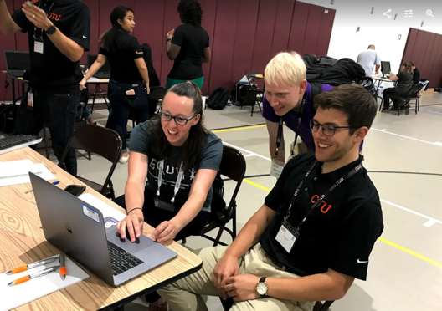
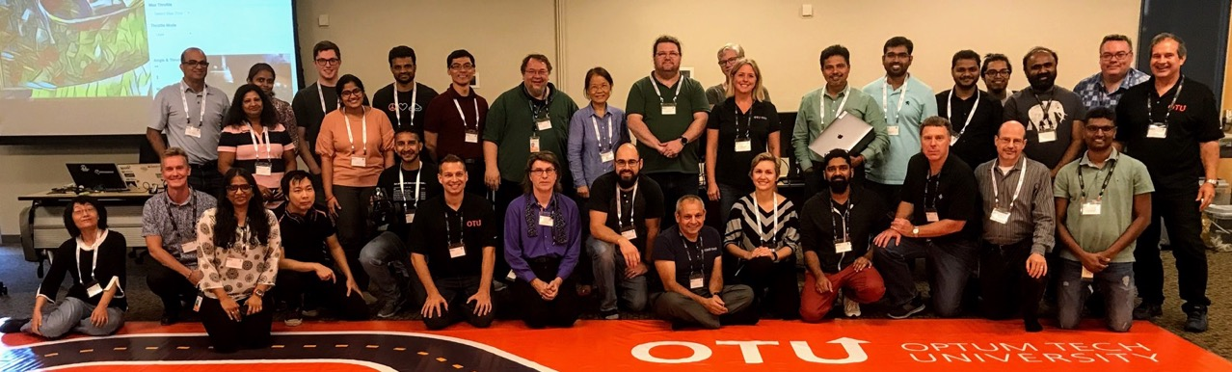
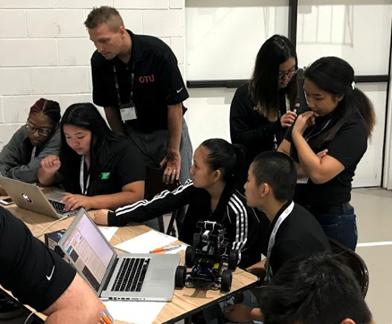
Mentor Training is the Key!

Slide 10
Thank You!
Our Web Site: http://codesavvy.org
Questions: kidscode@codesavvy.org
Scratch: http://coderdojotc.org/python
Mbot: http://dmccreary.github.io/coderdojo-robots
Python: http://coderdojotc.org/python
MicroPython (beta): http://coderdojotc.org/micropython
AI Racing League: https://coderdojotc.org/ai-racing-league
Mentor Resources: http://coderdojotc.org/CoderDojoTC

